Slide 1
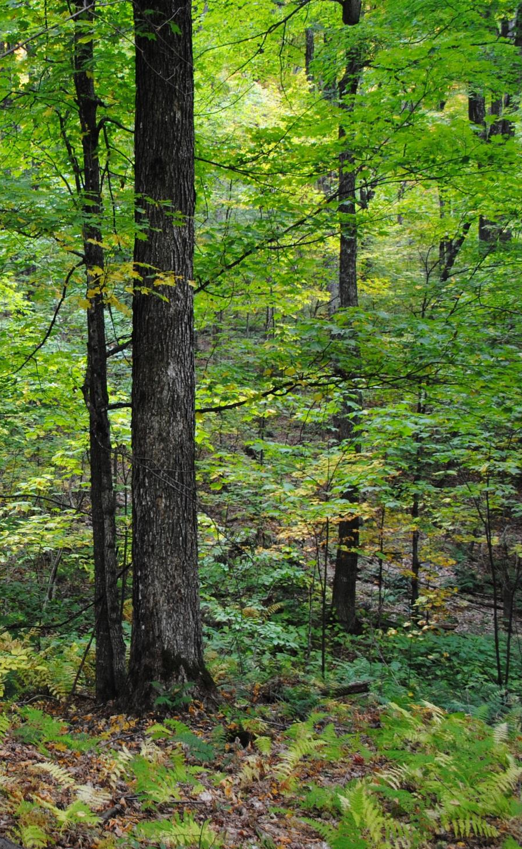
The Role of Forests
in Maintaining Water Quality
in the Lake Champlain Basin
Vermont Monitoring Cooperative Conference
Davis Center, University of Vermont
2 December 2016
Kristen L. Underwood ¹
Donna M. Rizzo ¹
Corrie Miller ²
Matt Witten ³
¹ Civil & Environmental Engineering,
UVM, Burlington, VT
² Friends of the Mad River
³ Addison County River Watch Collaborative
Notes:
Forests recognized for water quality benefits – including water filtration and retention

Slide 2
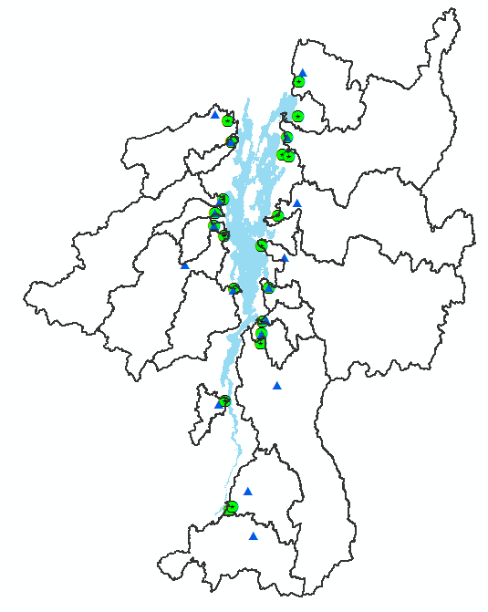
Lake Champlain Longterm
Tributary Monitoring Data
NYDEC, VTDEC, Quebec
22 tributaries
Monitored: 1990 – present
14 to 19 samples per year
Notes:
Longterm monitoring data for tributaries draining to Lake Champlain suggest a positive correlation between percent forest cover and higher-quality river water. However, this monitoring is done on a very coarse scale at the mouths of large basins. At the local level, towns and regional planning commissions are in need of finer-scale data to aid decision-making regarding stormwater management and nutrient loading to the Lake in the context of the Lk Champlain P TMDL.

Slide 3
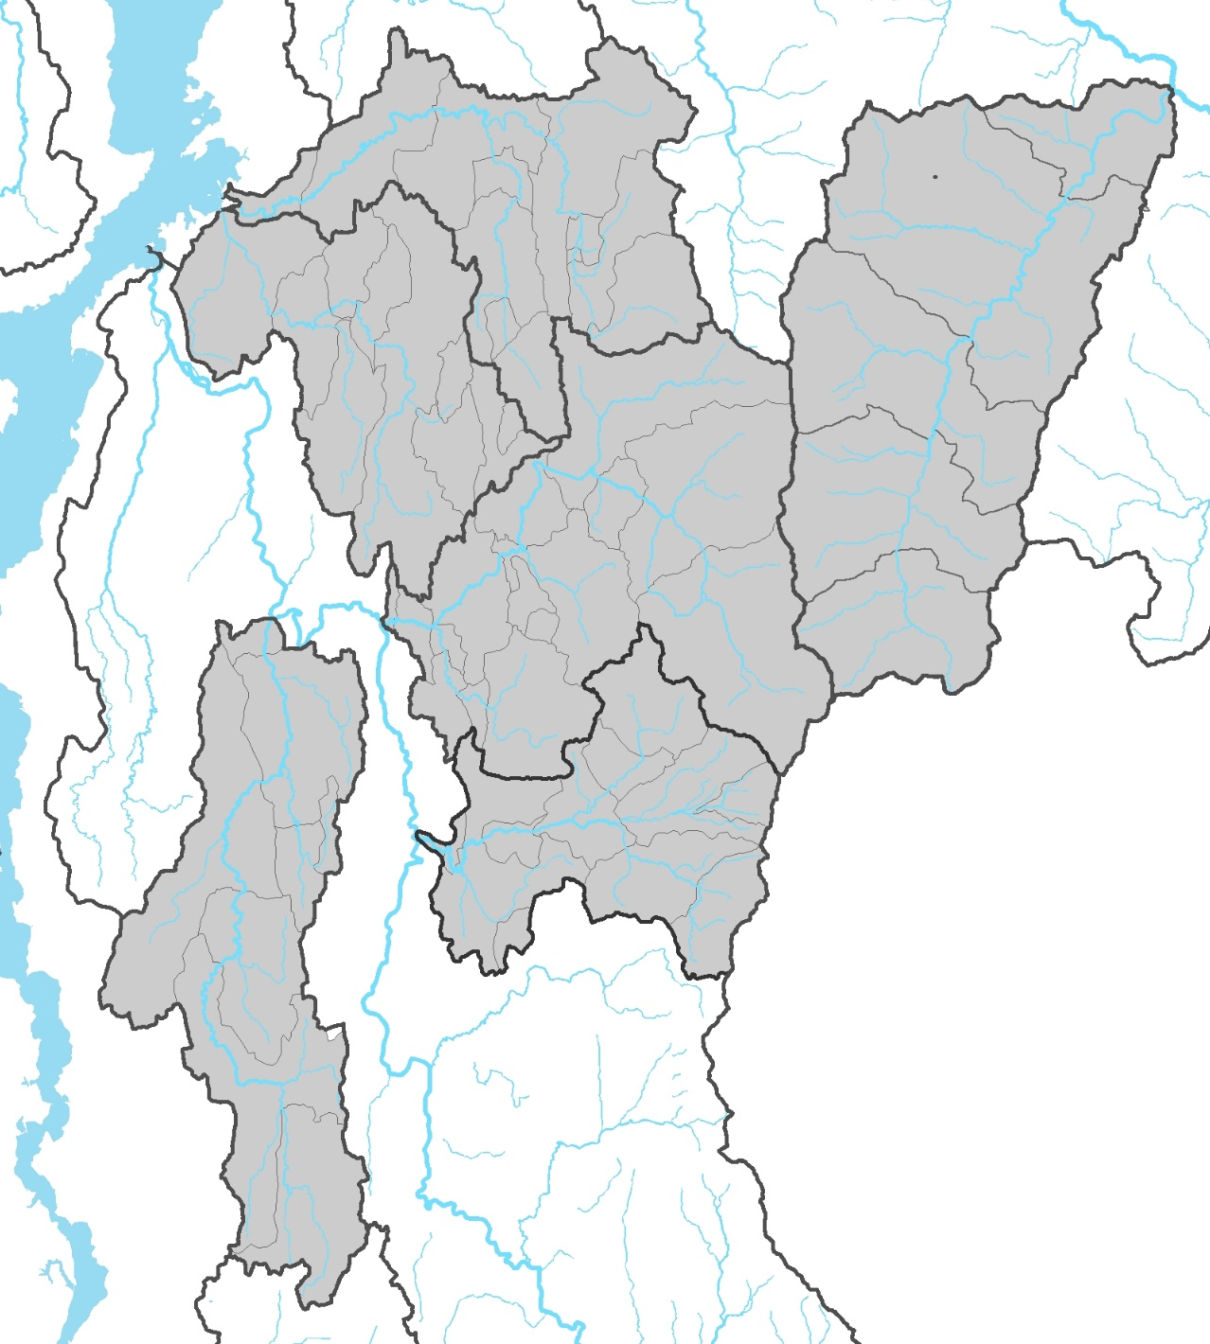
LaRosa Volunteer
Monitoring Data
Lewis
Creek
1990 - present
6+ samples/year
TP, Turbidity, E.coli
Little
Otter
Creek
Mad River
New Haven River
Middlebury River
Lemon Fair River
Notes:
Watershed groups like the Addison County River Watch Collaborative and the Friends of the Mad River have been monitoring water quality at the sub-watershed level for a quarter of a century. And this data set is now available for more detailed analysis of the land cover, land use and geologic factors that drive water quality in these Lake Champlain tributaries.

Slide 4
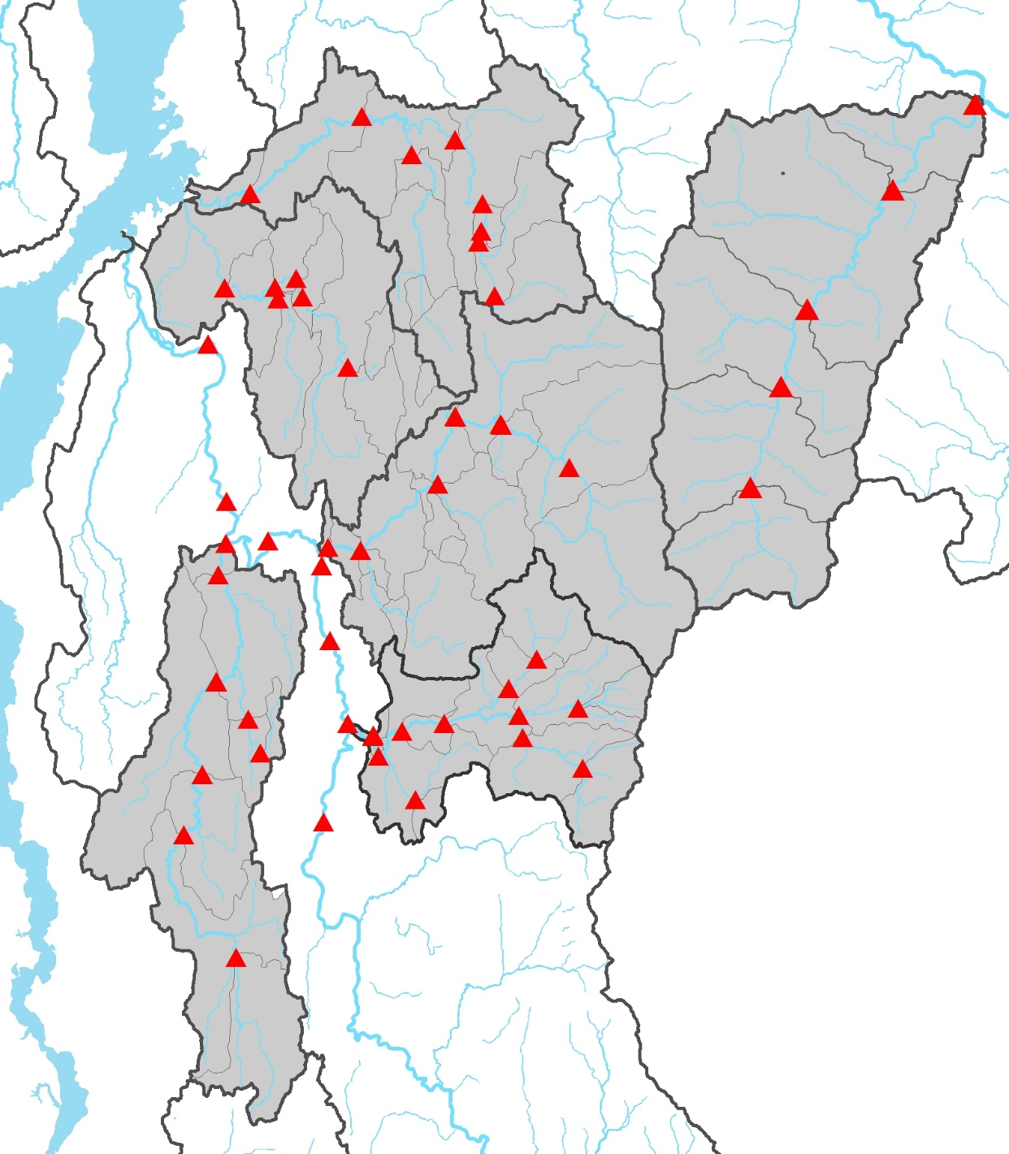
LaRosa Volunteer
Monitoring Data
1990 - present
6+ samples/year
TP, Turbidity, E.coli
Notes:
We analyzed water quality data from years 2010 through 2015 for 36 stations in six Lake Champlain Basin watersheds monitored by the Collaborative and Friends of the Mad River.

Slide 5
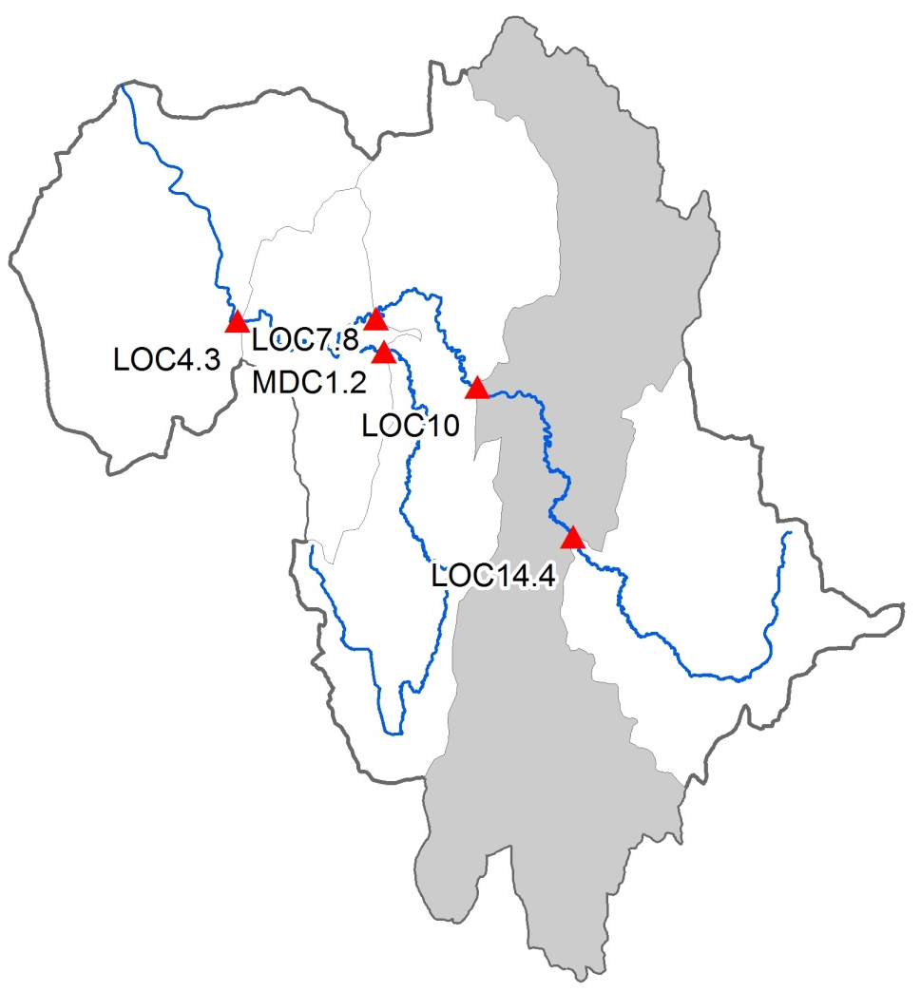
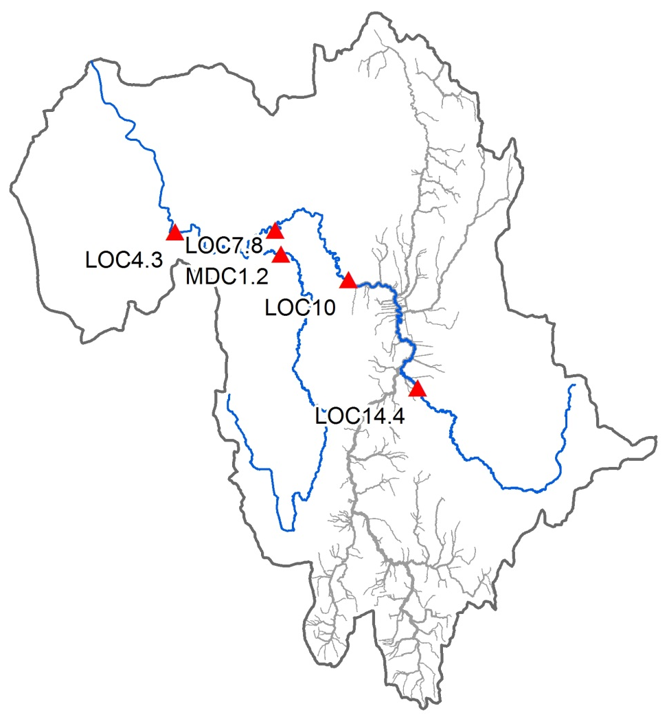
Unit Areas of Analysis - Direct Drainage Areas (DDA)
Sub-watershed DDA
Corridor DDA
Notes:
Generally speaking the water quality stations in these watersheds are located along the main stem and are considered nested stations. To maximize independence of observations, we analyzed land use and soil characteristics of Direct Drainage Areas between each successive water quality station.

Slide 6
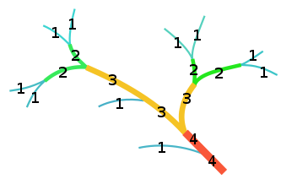
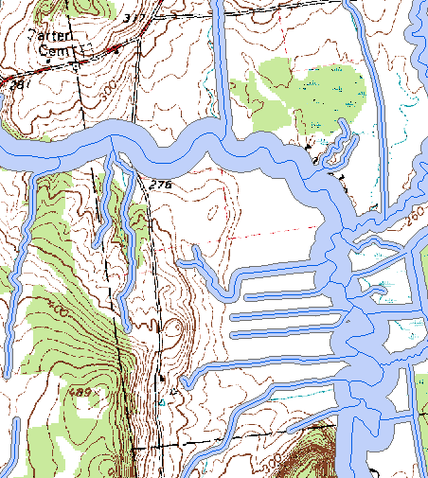
Unit Areas of Analysis
Corridor Delineation – buffered by Stream Order
VHD_CARTO buffered
Distance to one side of the stream center line.
Notes:
Corridor areas were developed by buffering the stream center line by variable widths corresponding to the Strahler stream order of the stream segment.

Slide 7
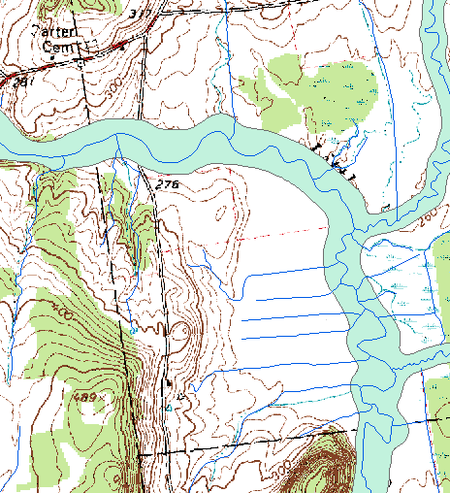
Unit Areas of Analysis
Corridor Delineation – buffered by Stream Order
VHD_CARTO buffered
VTANR River Corridor

Slide 8
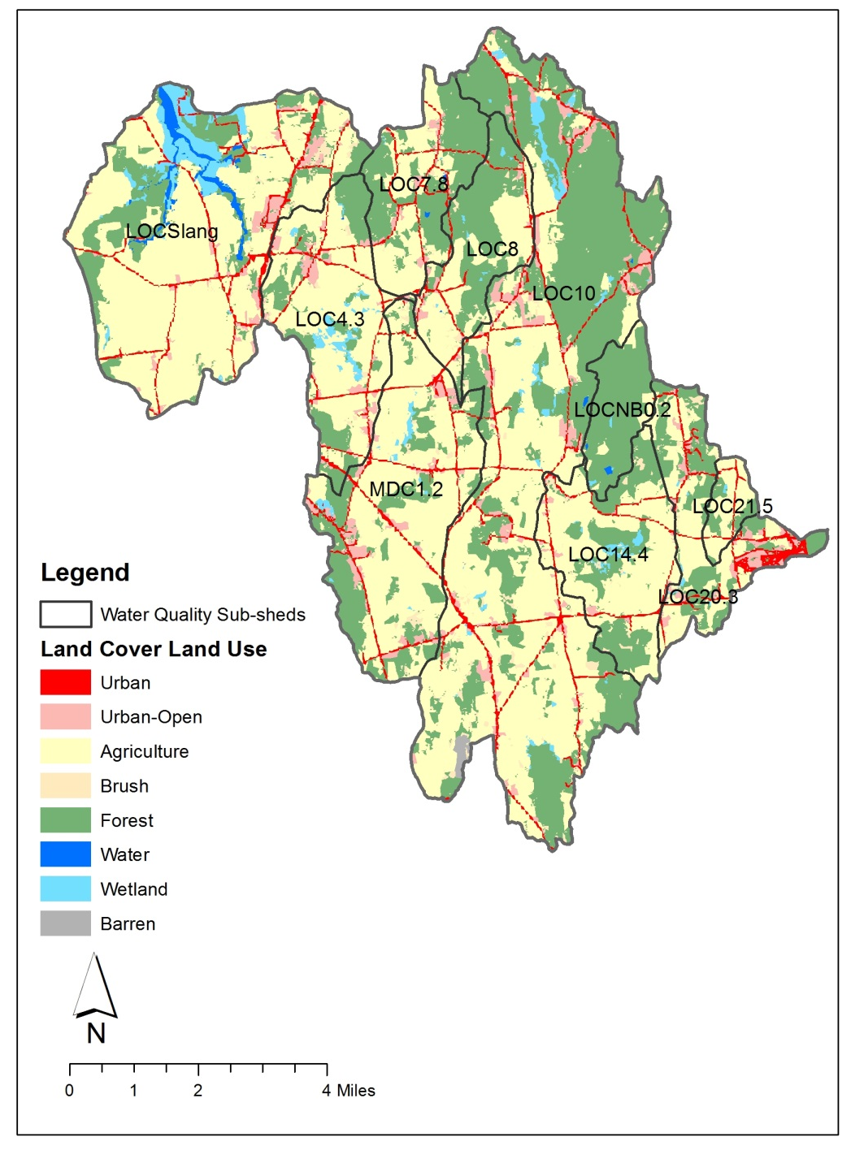
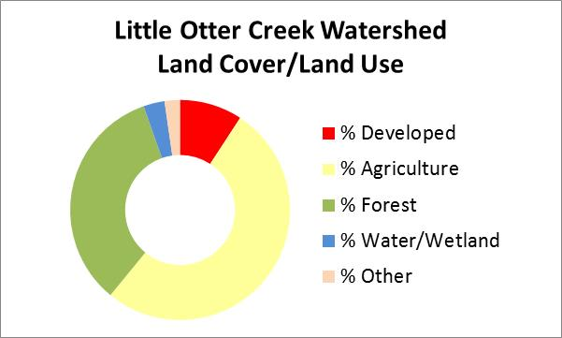
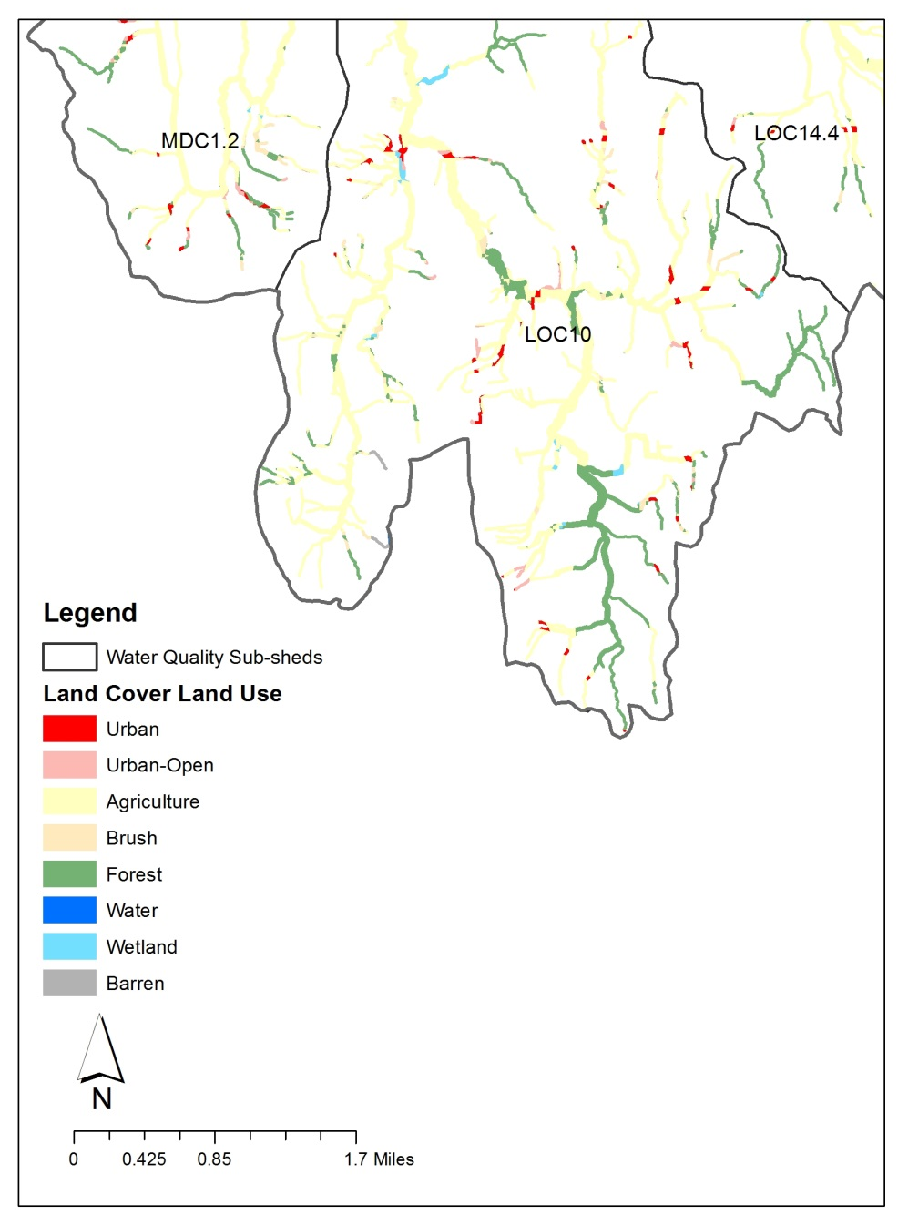
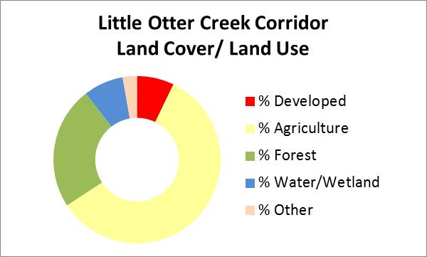
Compile Land Cover Data
Notes:
Land cover data were summarized from the 2001 Lake Champlain Basin Land Cover data set (Austin Troy and colleagues from the UVM SAL). Data were compiled for both the Subshed and Corridor DDAs.

Slide 9
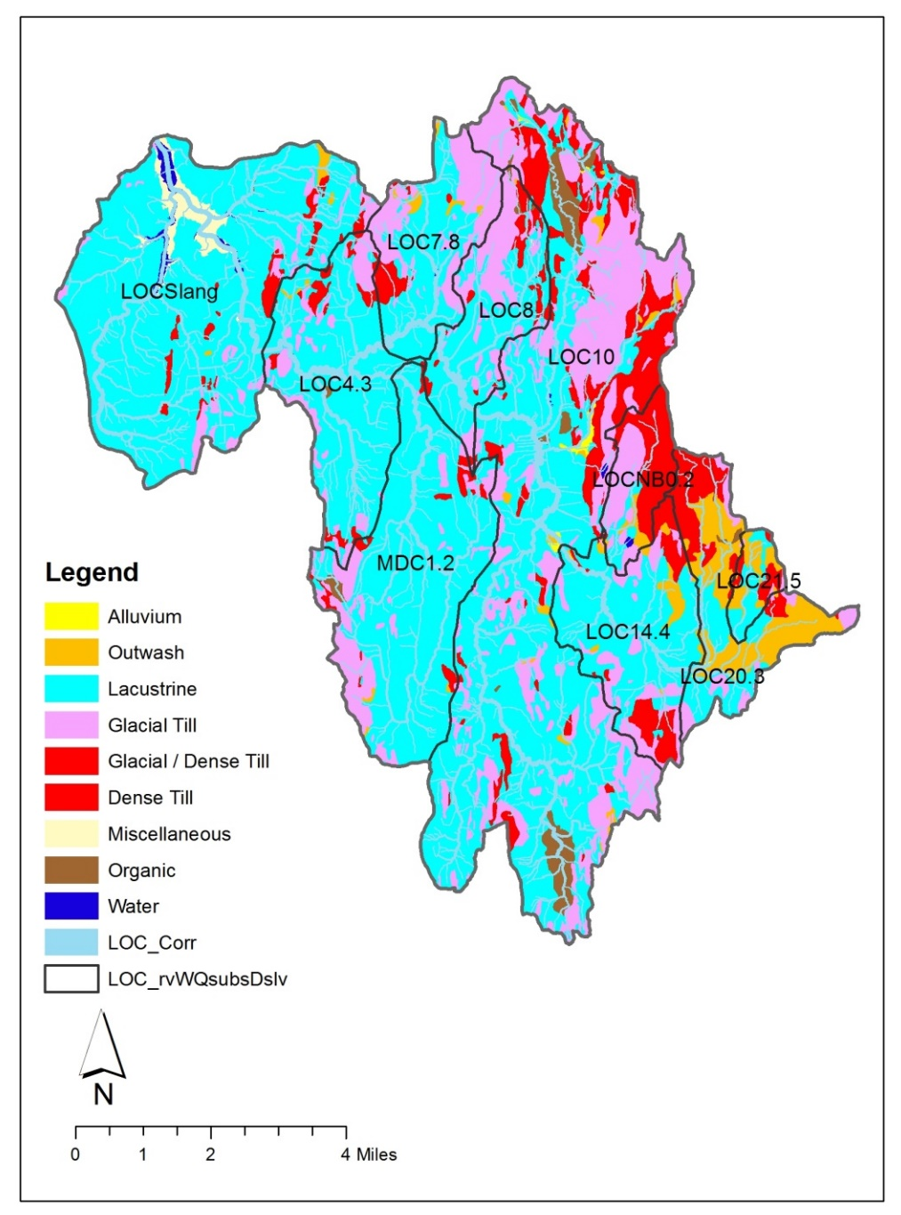
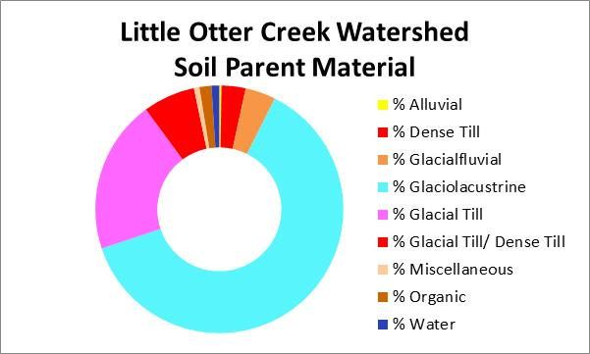
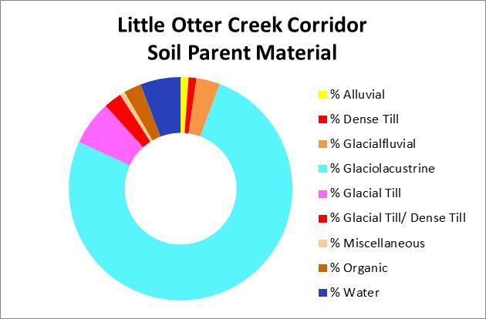
Compile Soils Data
Notes:
Soil data were sourced from SSURGO data sets and joined with Table 20 attribute data to get at soil parent materials and runoff potential as captured by Hydrologic Soil Groups (not shown).

Slide 10
Correlations to Water Quality
Notes:
Relationships between variables were examined using the Pearson correlation coefficient, to identify those characteristics strongly correlated to water quality. For example, the percentage of agricultural land use at the Subshed scale is a relatively strong predictor of mean TP concentration in the river draining that area (r = 0.866) and these variables are positively correlated. Equally strong and positive relationship is exhibited for glaciolacustrine soils and TP. Generally speaking, the strength of the correlations increased when considering the Corridor scale over the Subshed scale. (Similar results obtained using Spearman Rank Correlations and Kendall’s Tau).

Slide 11
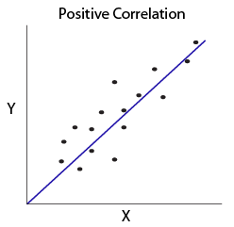
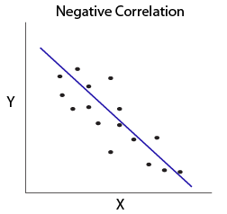
Correlations to Water Quality
Positively
Negatively
% Glacial Lake Soils
% Very low infiltration soils (HSG D)
% Low infiltration soils (HSG D and C)
% Agricultural land use
% Moderate infiltration soils (HSG B)
% Forested land use
Total Phosphorus
Turbidity
Total Phosphorus
Turbidity
Notes:
In summary, analysis of soil and land use characteristics in direct-drainage areas to each of the 36 stations, at both the Subshed and Corridor scales revealed strong, and statistically-significant, positive correlations between mean water quality concentrations (TP, Turbidity, and E.coli) and percent glacial lake soils, percent very-low and low-infiltration soils, and percent agricultural use. Conversely, percent forest cover was strongly correlated, in a negative sense to concentrations of these same constituents.

Slide 12
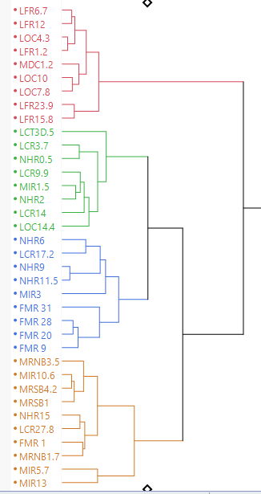
3
Hierarchical Clustering
A method to group together observations that are more similar to one another.
Output is a branching diagram that identifies clusters of similar observations.
Examined Turbidity and TP data by cluster
ANOVA / Tukey HSD indicated separation between Clusters for three main groupings
2
1
Notes:
Given the strong correlation between some watershed characteristics and water quality, can we cluster together sub-watersheds that have similar soil and land use characteristics and see if they have similar water quality? If so, this clustering could be useful for prediction, and for prioritizing implementation projects in our watersheds. We used a method called hierarchical clustering to group together observations that are more similar to one another. . Inputs to this algorithm were only the soil and land use metrics. Clustering analysis identified four distinct groups. Later ANOVAs on water quality data for these four groups indicated separation between only three groups.

Slide 13
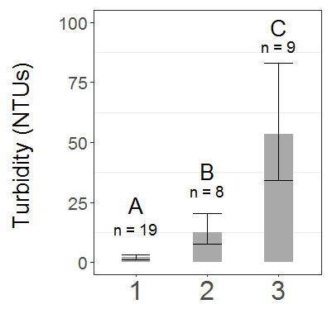
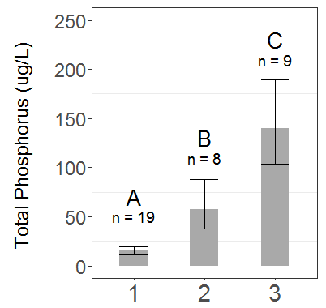
Water Quality Results by Cluster
Mean Turbidity
Corridor DDAs by Cluster
Mean Total Phosphorus
Corridor DDAs by Cluster
1
2
3
1
2
3
ANOVAs performed on transformed variables. Bar graphs depict back-transformed mean values. Whiskers = back-transformed values for +/- 95% Confidence Intervals
Notes:
We then examined the water quality data for these groupings to understand if there were meaningful differences between these clusters, using a one-way Analysis of Variance. Cluster 1 has higher TP than Cluster 2, which itself has higher TP than the other clusters. And these differences are statistically significant as measured by Tukey’s Honest Significant Difference test.

Slide 14
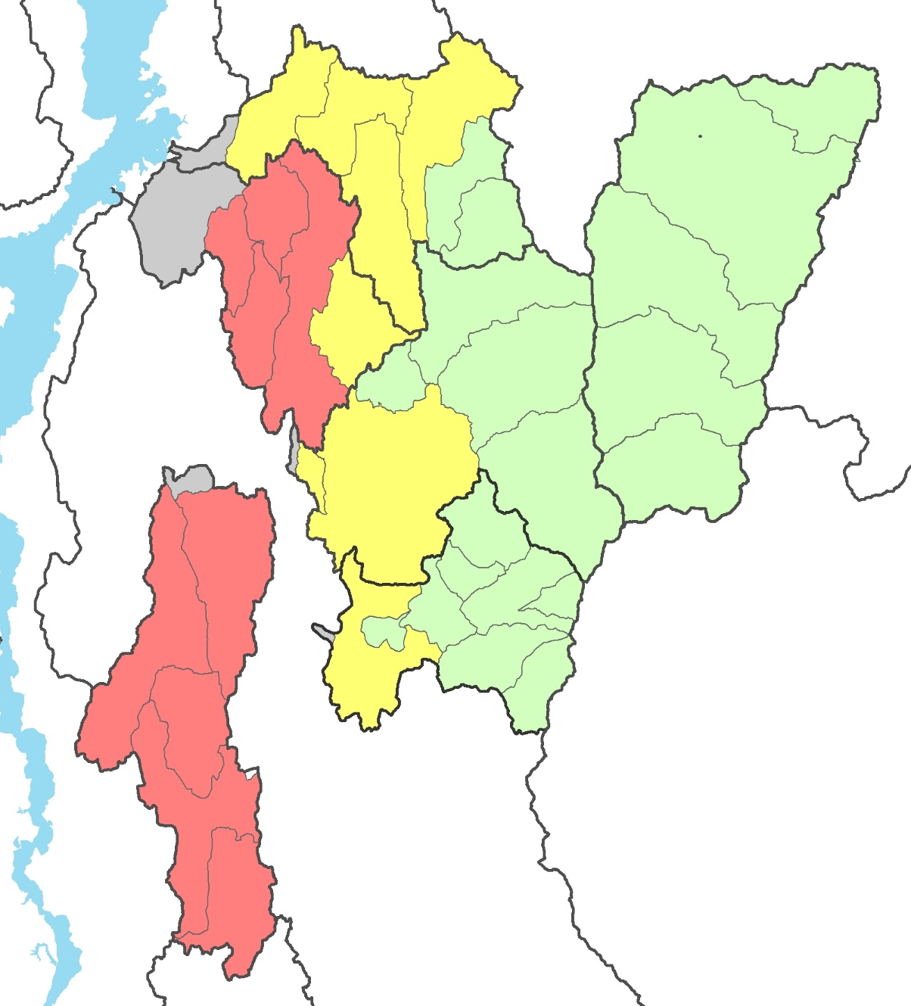
Clustering Outcome
1
2
3
Notes:
Partitioning subwatersheds on the basis of soil and land use characteristics correlated to water quality has utility for prioritizing watershed improvement practices in these basins. The Collaborative and its partners will be focusing future restoration and conservation efforts in those subwatersheds with higher concentrations of nutrients and pathogens. Results also underscore the importance of intact, healthy forest blocks and forested riparian areas for maintaining water quality.

Slide 15
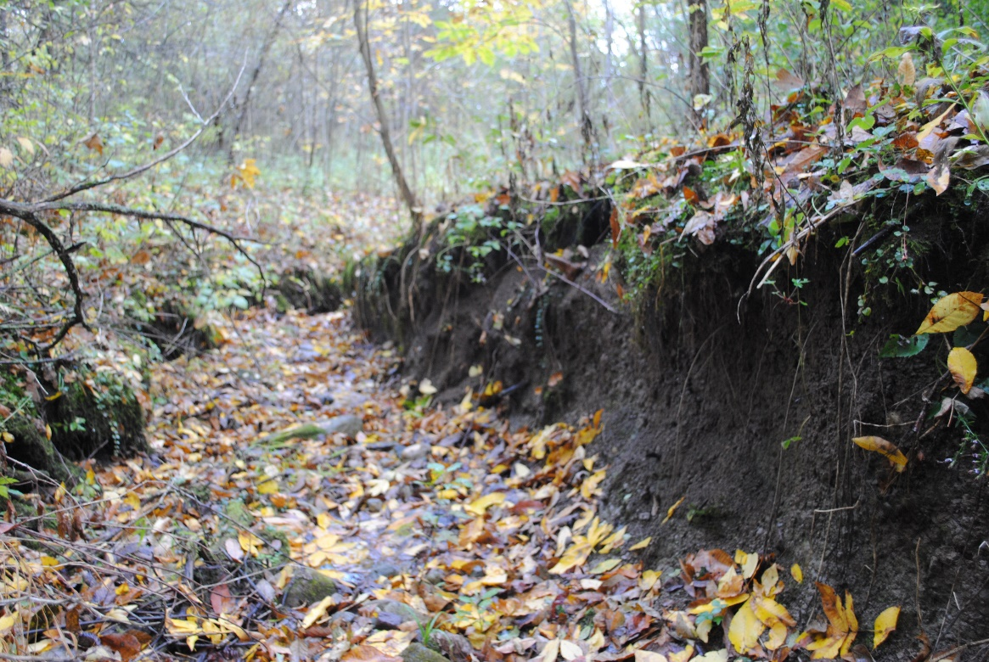
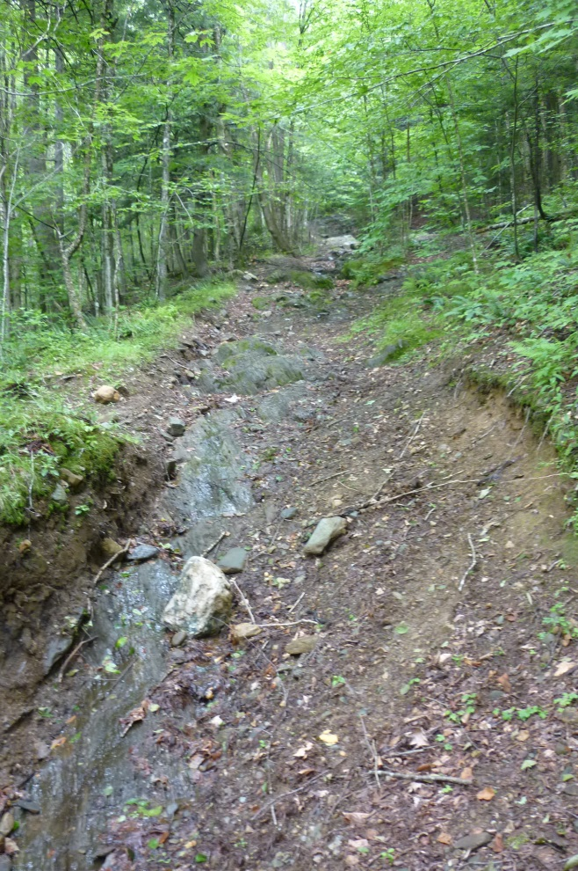
Forested Headwaters
Steep-slopes,
low-infiltration soils
Stormwater:
SLOW IT, SPREAD IT, SINK IT
Notes:
Doesn’t mean that we don’t have challenges in our forested areas – particularly, steep headwaters – where legacy impacts such as old road and trail networks tend to concentrate stormwater runoff and deliver it quickly to our lowland areas, increasing peak flows and magnitudes. We need to focus on practices to slow, spread and sink stormwater in these forested headwaters to reduce impacts to down-valley areas.

Slide 16






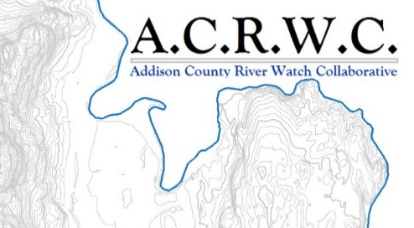


Acknowledgements

